Slide 1
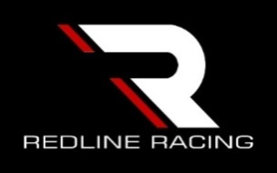
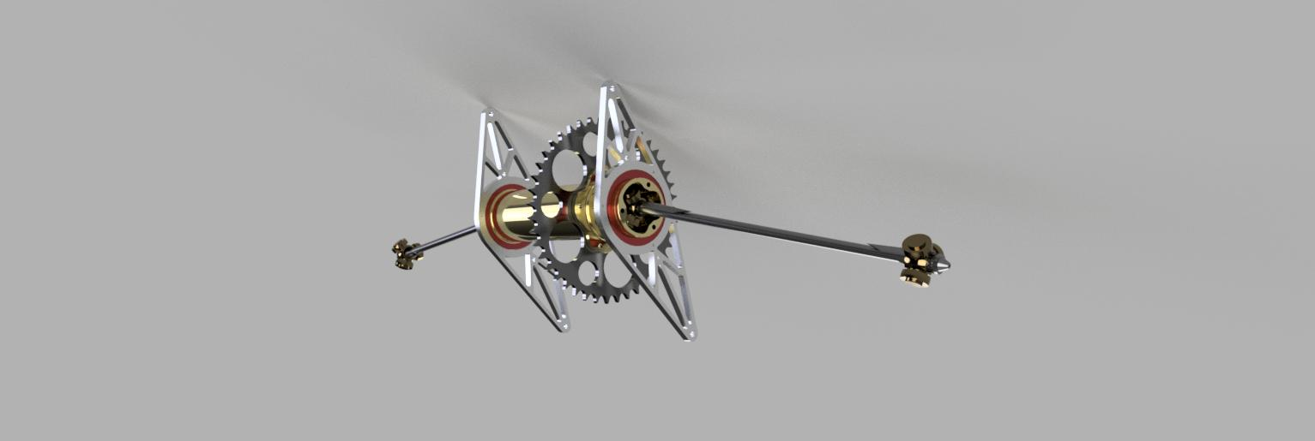
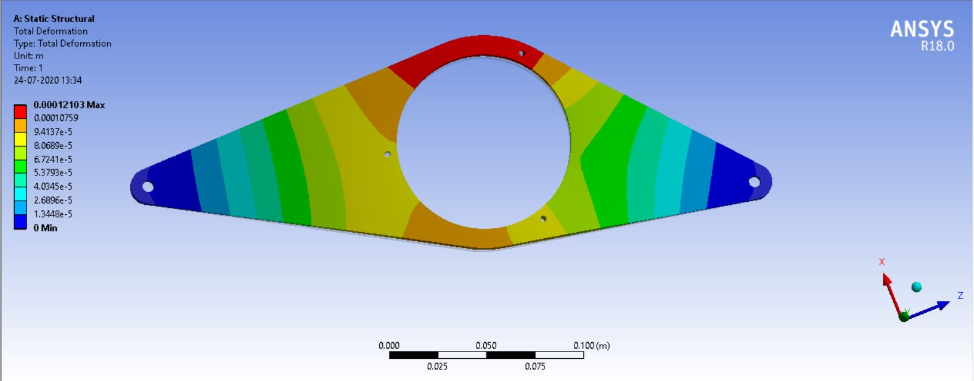
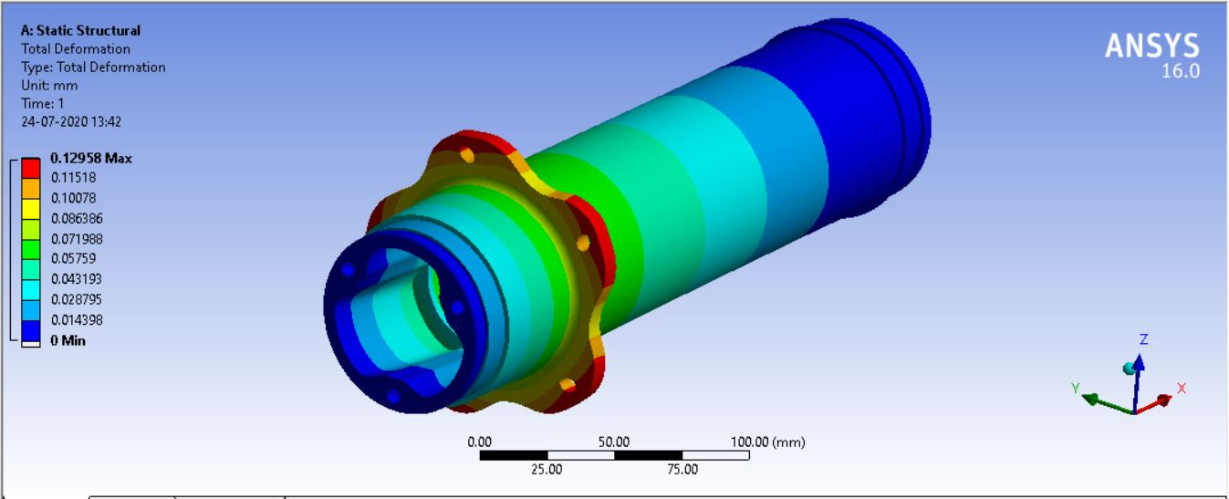
Considerations in the system design
Setting the Design Objectives
Type of Power transmission
Selection of Differntial
Design of Sprocket
Material Selectiom
Design of spoolmount
Manufacturing of Scattershield
Manufacturing of all components and Assembely
Shaft Calculations
And Design
DFMEA of the system
Design Of Spool
Material Selection
No of Teeth Calculations
DRIVETRAIN
USP:
Lightest Integrated Spool in Industry.
Aluminium Sprocket.
DESIGN CONSIDERATIONS
Maximum Torque =1500Nm
Max RPM of Tyre =1450
To design a system with optimum wt.
Parameters | Spool | Open Differential | Limited Slip Diff.
Power Loss | 1 | 3 | 5
Reliability | 5 | 3 | 1
Weight | 1 | 3 | 5
Cost | 1 | 3 | 5
Maintanance | 1 | 3 | 5
No. of teeth On Pinion | 15
No. of Teeth on Sprocket | 43
Max. Torque Transmitted | 1420Nm
Max. Velocity of Vehicle | 110Kmph
TEAM R E D L I N E R A C I N G

